Slide 1
Module: Service Management
Upon completion of this module, you should be able to:
Describe service portfolio management processes
Describe service operation management processes
Notes:
This module focuses on the service management cross-layer function of the cloud computing reference model. This module focuses on service portfolio management and service operation management processes.

Slide 2
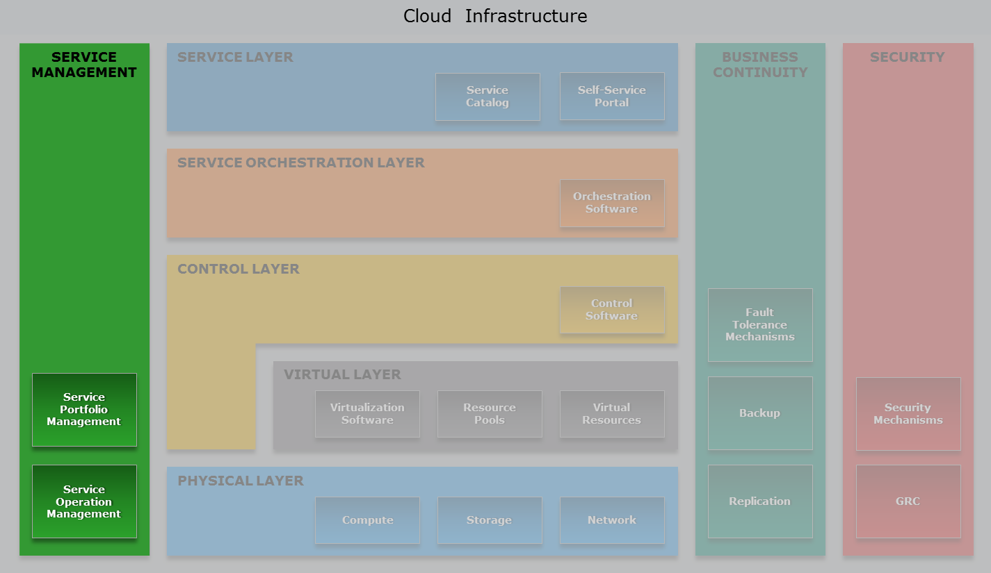
Cloud Computing Reference Model
Service Management Cross-layer Function
Notes:
The service management cross-layer function—highlighted in the figure on the slide—supports service portfolio planning and administrative operations across all the layers of the cloud infrastructure with a goal to meet service requirements.

Slide 3
Lesson: Service Management Overview
This lesson covers the following topics:
Overview of cloud service management
Overview of service management functions
Notes:
This lesson covers an overview of cloud service management and its key functions.

Slide 4
Introduction to the Cloud Service Management
Cloud Service Management
All of the service-related functions that are necessary for the management and operation of those services required by or proposed to cloud consumers.
─ NIST
Performed by administrators of service provider’s organization
Linked to the cloud service requirements and SLA
Ensures that cloud services are delivered and operated optimally
Using as few resources as needed
Notes:
The U.S. National Institute of Standards and Technology (NIST) in its Special Publication (SP) 500-291, Version 2 describes cloud service management as: “cloud service management includes all of the service-related functions that are necessary for the management and operation of those services required by or proposed to cloud consumers.” These functions align the creation and delivery of cloud services to the provider’s business objectives and to the expectations of consumers. They are performed by the administrators of provider’s organization.
Cloud service management has a service-based focus, meaning that the management functions are linked to the service requirements and service level agreement (SLA). For example, when a service provider needs to make a change in a service, the service management ensures that the cloud infrastructure resources are configured, modified, or provisioned to support the change; likewise, it ensures that cloud infrastructure resources and management processes are appropriate so that services can maintain the required service level. Additionally, cloud service management ensures that the cloud services are delivered and operated optimally by using as few resources as needed.

Slide 5
Traditional IT Management vs. Cloud Service Management
Traditional IT Management
Element/asset specific management
Cloud Service Management
Service-related management that meets service requirements
Overly complex, especially for large environments
May not support service oriented infrastructure
May be unsuitable for on-demand service provisioning, rapid elasticity, workflow orchestration, and sustained service levels
Management processes are implemented separately from service design
End-to-end management across all IT assets in a cloud
May encompass massive, multi-vendor cloud infrastructure
Optimized to handle increased complexity, change rates, and risk exposure
Adopt automation and workflow orchestration
Support rapid deployment, elasticity, and service mobility
Notes:
Traditional IT management: Traditionally, IT management is infrastructure element or asset (such as compute, storage, and business application) specific. The management tools provided by IT asset vendors only enable monitoring and management of specific asset(s). A large environment composed of many multi-vendor IT assets residing in world-wide locations raises management complexity and asset interoperability issues. Further, traditional management processes and tools may not support a service oriented infrastructure, especially if the requirement is to meet on-demand service provisioning, rapid elasticity, workflow orchestration, and sustained service levels. Even if traditional management processes enable service management, they are usually implemented separately from service planning and design, which may lead to gaps in monitoring and management.
Cloud service management: Management in the cloud has a service-based focus commensurate with the requirements of each cloud service rather than an asset-based focus. It is based on a holistic approach that must be able to span across all the IT assets in a cloud infrastructure. Depending on the size of a cloud environment, service management may encompass a massive IT infrastructure comprising multi-vendor assets, a variety of technologies, and multiple data centers. Compared to traditional IT management, cloud service management must be optimized to handle increased flexibility, increased complexity, increased data access, increased change rates, and increased risk exposure that may lead to service outages and SLA violations. In order to operate sustainably in a cloud environment, service management must rely on automation and workflow orchestration. Cloud service management may still follow the traditional IT service management processes such as ITIL; however, the processes should support cloud rapid deployment, orchestration, elasticity, and service mobility.

Slide 6
Service Management Functions
Service portfolio management
Defines the suite of service offerings that aligns to the provider’s strategic business goals
Service operation management
Maintains cloud infrastructure and deployed services, ensuring that services and service levels are delivered as committed
Often service portfolio management and service operation management are performed jointly
Notes:
Cloud service management performs two key functions:
Service portfolio management: It defines the suite of service offerings, called service portfolio, aligning it to the provider’s strategic business goals.
Service operation management: It maintains cloud infrastructure and deployed services, ensuring that services and service levels are delivered as committed.
Often service portfolio management and service operation management are performed jointly, providing the capability to create viable cloud services that meet consumer expectations and market demand, and compete appropriately on service price, quality, and time-to-provision.
These functions are detailed in the subsequent slides.

Slide 7
Lesson Summary
During this lesson the following topics were covered:
Overview of cloud service management
Comparison between traditional IT management and cloud service management
Overview of service portfolio management and service operation management
Notes:
This lesson covered an overview of cloud service management and a comparison between traditional IT management and cloud service management. It also covered an overview of service management functions – service portfolio management and service operation management.

Slide 8
Lesson: Service Portfolio Management
This lesson covers the following topics:
Service portfolio management activities
Key processes to support portfolio management
Notes:
This lesson covers service portfolio management activities and the key processes to support portfolio management.

Slide 9
Introduction to Service Portfolio Management
Service portfolio management involves making decision to deliver those services that provide value and strategic advantage to the provider
Portfolio Management Activities
Defines service enablement roadmap, service features, and service levels
Assesses and prioritizes where investments are most needed
Establishes budgeting and pricing
Deals with consumers in taking orders, processing bills, and collecting payments
Performs market research
Collects information about competing service offerings
Measures service adoption
Analyzes feedback from consumers
Modifies and aligns services according to consumer needs and market condition
Notes:
Cloud administrators responsible for service portfolio management make decision to deliver those services that provides value and strategic advantage to the provider. They provide guidelines on how these services will be designed, implemented, supported, and priced (where appropriate). They also make investment decision on services across services’ entire lifecycle and ensure that services are delivered in the most cost-effective manner and as quickly as possible.
A chart showing service portfolio management activities are provided on the slide.

Slide 10
Portfolio Management Processes
Key processes to support portfolio management activities are:
Service catalog management
Financial management
Supplier management
Notes:
A list of key processes that support portfolio management activities are provided in the slides. These processes are described next.
Note: Though the aim is not to promote any particular service management methodology as ideal for cloud, this module follows ITIL service management practices that are widely known across IT organizations.

Slide 11
Service Catalog Management
Goal
Ensure that a service catalog is created and maintained with accurate information on all of the available services.
Responsible for design and implementation of service catalog
Updates service catalog to include new service offerings and/or changes to the existing offerings
Ensures that information in service catalog is:
Up-to-date
Clear and complete
Unambiguous and valuable to consumers
Notes:
The goal of service catalog management is to ensure that a service catalog is created and maintained with accurate information on all of the available services. As described before in the ‘Service and Orchestration Layers’ module, the service catalog, available through the cloud portal, is the menu of services that lists services, attributes of services, and associated prices. The key functions of service catalog management are described below:
Service catalog management team is responsible for the design and implementation of the service catalog. It updates the service catalog to incorporate new service offerings or changes to the existing service offerings. Changes to the service offerings are communicated to service catalog management through an orchestrated workflow that first routes change decisions through a change management process. Following affirmative change decisions, the service catalog management updates the service catalog to include the new services and/or changes to the existing service offerings. Change management is described later in this module.
Service catalog management team ensures that the information in the service catalog is up-to-date. It emphasizes clarity, completeness, and usefulness when describing service offerings in the service catalog, ensuring that the features, intended use, comparisons, prices, order process, and levels of services are unambiguous and valuable to the consumers.

Slide 12
Service Catalog Design and Implementation Process
Define service attributes through portal software interface
Define web form used to request the service using portal software
Create Service Definition
Define Service Request
Publish Service
Define Fulfillment Process
Publish service catalog to the consumers
Model process that fulfills delivery of service
Notes:
The service catalog design and implementation process consists of a sequence of steps. These are:
Create service definition: Creating a definition for each service offering is the first step in designing and implementing the service catalog. A service definition comprises service attributes such as service name, service description, features and options, provisioning time, and price. The cloud portal software provides a standard user interface to create service definitions. The interface commonly provides text boxes, check boxes, radio-buttons, and drop-downs to make entries for the service attributes.
Define service request: After creating a service definition, the next step is to define the web form used to request the service. The portal software includes a form designer for creating the service request form that consumers use to request the service.
Define fulfillment process: After defining the service request form, the next step is to define the process that fulfills delivery of the service. Once the process is modeled, approved, and validated, it is implemented using workflows in the orchestrator.
Publish service: The final step is to publish the service catalog to the consumers. Before publishing, it is a good practice to perform usability and performance testing. After the service is published, it becomes available to consumers on the cloud portal.

Slide 13
Cloud Portal Views
Service catalog management team creates different portal views:
Service management-specific view:
Service asset details
Order status
Resource bundling issues
Orchestration failures
Consumer-specific view:
Consumer-facing value of service
Service policies and rules
Information on rented service instances and utilized resources
Incident status and billing report
Notes:
Service catalog management team usually creates different views of or personalizes the cloud portal to meet different requirements of the cloud administrators and the consumers. These are:
Service management-specific view: It is only visible to the cloud administrators and contains details of all service assets and support services to provision a cloud service. It is useful to track order status, and check resource bundling issues and orchestration failures.
Consumer-specific view: It comprises a description of services including the business processes they support, consumer-facing value of the services, and service policies and rules. It also provides information on rented service instances and utilized resources, incident status, and billing reports. It enables consumers to request any changes to services, decommission service instances, and use technical support services.

Slide 14
Financial Management
Goal
Manage the cloud service provider's budgeting, accounting, and billing requirements.
Financial management team with provider’s finance department plans for investments and IT budget
Financial management team provides business cases for investments
Finance department does cost analysis, budget adjustment, and accounting
Determines price per service to meet the provider’s business goal
Defines billing policy based on service-specific pricing strategy
Notes:
The goal of financial management is to manage the cloud service provider's budgeting, accounting, and billing requirements. The key functions of financial management are described below:
The financial management team, in collaboration with the provider’s finance department, plans for investments to provide cloud services and determines the IT budget for cloud infrastructure and operations for the lifecycle of services. The financial management team is responsible for providing any necessary business cases for investments, while the finance department may help out with cost analysis, budget adjustment, and accounting. The business case usually includes financial justification for a service-related initiative including demand forecast of services, service stakeholders inputs, sources of initial and long-term funding, and value proposition for the business. The business case provides visibility into the financials and helps communicate the initiatives to the top executives.
Financial management team is responsible for performing service valuation. Service valuation determines the price a consumer is expected to pay for a service, which helps recover the cost of providing the service, ensuring profitability, and meeting the provider’s return on investment (ROI) and reinvestment goals. Financial management team defines the billing policy based on the service-specific pricing strategy. It manages the deployment of billing system or tool that enables administrators to define the billing policy. Based on the policy, the billing system automatically collects billing data, stores billing records in a database, and generates the billing report per consumer.

Slide 15
TCO and ROI
Investment decisions are usually factored by Total Cost of Ownership (TCO) and Return On Investment (ROI)
t= Service asset lifetime
∑
TCO =
One-time costs + Recurring costs (t)
t=1
(Gain from investment – Cost of investment)
ROI =
Cost of investment
One-time costs – CAPEX
E.g. procurement and deployment costs of hardware
Recurring costs – OPEX
E.g. power, cooling, facility, and administration costs
Notes:
Investment decisions are usually factored by total cost of ownership (TCO) and return on investment (ROI). These are described below:
TCO estimates the full lifecycle cost of owning service assets. The cost includes capital expenditure (CAPEX), such as procurement and deployment costs of hardware and on-going operational expenditure (OPEX), such as power, cooling, facility, and administration cost. CAPEX is typically associated with one-time or fixed costs. Recurring costs or variable costs are typically OPEX that may vary over the life of a service.
ROI is a measurement of the expected financial benefit of an investment. It is calculated as the gain from an investment minus the cost of the investment, and the whole is divided by the cost of the investment.
The formulae to calculate TCO and ROI are shown on the slide.

Slide 16
Service Pricing
Map service assets to relevant services
Divide aggregated cost by some logical unit of demand
Aggregate All Costs (CAPEX and OPEX) Per Service
Calculate Per-unit Service Cost
Add Margin over Service Cost or Establish Price at Service Cost
Establish a Stable Per-unit Cost Baseline
Based on service provider’s business goal
Based on service demand or utilization over time
Notes:
Financial management team performs a series of steps to determine the price for a service. These steps are:
It aggregates all types of costs (both CAPEX and OPEX) down to service asset level of granularity by mapping assets to relevant cloud services.
It calculates service cost on per-unit basis by dividing the aggregated cost for a service by some logical unit of demand such as GB of storage or an hour of usage for that service.
The per-unit service costs may vary over time, depending on the demand for or utilization of the services and service assets. Thus, financial management through specialized management tools should track the demand and utilization to establish a stable per-unit cost baseline.
Finally, financial management team may add some margin amount over per-unit service cost to define service price, or may establish the price at the true cost of service depending on the provider’s business goal.

Slide 17
Supplier Management
Goal
Ensure that all contracts with the suppliers of cloud products, technologies, and supporting services meet the business requirements of the cloud service provider and that the suppliers adhere to contractual commitments.
Gathers and evaluates information on different suppliers of cloud product and technologies suitable for provider’s needs
Lists preferred suppliers and builds criteria for selection
Selects most suitable supplier from the list of prospective suppliers
Notes:
The goal of supplier management is to ensure that all contracts with the suppliers of cloud products, technologies, and supporting services meet the business requirements of the cloud service provider and that the suppliers adhere to contractual commitments. Cloud service providers usually obtain IT products and services from multiple suppliers to build and maintain cloud infrastructure and provide cloud services to their consumers. Examples of suppliers to cloud service providers are hardware and software vendors, network and telecom service providers, and public cloud service providers (IT department functions as cloud service broker).
Key functions of supplier management are described below:
The supplier management team gathers and evaluates information on different suppliers that are enabling cloud technologies and making product offerings suitable for the provider’s business and technical needs. The supplier management team creates a list of preferred suppliers and builds criteria for the selection of suppliers and their products and services. From the list of prospective suppliers, it selects the most suitable supplier.
(Cont'd)

Slide 18
Supplier Management (Cont'd)
Negotiates and agrees on terms in the contracts with suppliers
Evaluates quality and cost of supplies against changing business needs and SLAs
Reassesses contract renewal, extension, and termination
Manages relationships with suppliers through communication
Supply guarantees
Price and payments
Delivery timeline
Responsibilities
Contract renewal and termination options
Dispute resolution
Provider’s business strategy
Risks associated with a delivery
Required changes in the contract
Improvements needed in products and services
Notes:
A provider usually enters into a contract with each supplier, which legally underpins the supply of products and supporting services. Supplier management team prepares terms and conditions for the contracts and creates a framework for the procurement of supplies. It negotiates and agrees on the terms in the contracts with the suppliers and ensures that the value for money is obtained. During contract negotiations, emphasis is placed on supply guarantees, price and payments, delivery timeline, responsibilities, contract renewal and termination options, and dispute resolution. While negotiating the termination option, the supplier management team should assess the terms and conditions under which the relationships with suppliers will end, addressing potential vendor lock-in issues. Further, it ensures that the procurement timeline aligns with the demand for resources in the cloud infrastructure and relevant SLAs.
Supplier management team periodically evaluates the quality and cost of the products and services offered by the suppliers against changing business requirements of service provider and SLAs. Based on this, it reassesses the existing suppliers and contracts and plans for contract renewal, extension, and termination.
Supplier management team manages the relationships with the suppliers and communicates about the provider’s business strategy, risks associated with a delivery, required changes in the contract, and improvements needed in products and services.

Slide 19
Common Criteria to Select Suppliers
Compatibility of the supplier’s products or services with the provider’s current and future cloud service strategy
Percentage of provider’s requirements addressed by the supplier’s products
Quality of the product or service to meet SLA
Supplier’s expertise in the cloud product and technology market
Supplier’s ability to provide unique technologies that enable differentiation in the market
Notes:
A list of common criteria for selecting suppliers is provided on this slide and the next slide.

Slide 20
Common Criteria to Select Suppliers (Cont'd)
Supplier’s willingness to:
Share technology roadmap
Provide some visibility and control into their environment
Build a relationship
Timeliness and efficiency in technical support
Price competitiveness
Financial stability of the supplier
Consumer references about specific supplier product or technology
Global presence to support the provider’s data centers

Slide 21
Supplier Management Example
Reassess Suppliers
Existing contract with four suppliers:
Supplier A
Supplier B
Supplier C
Supplier D
Suppliers Performance Report
Supplier | Renewal Date | Number of Contracts | Compliance | Disputes | Total Cost | Satisfaction
Supplier A | 11/12/15 | 3 | 94% | 0 | $3,056,958.66 | 9
Supplier B | 03/19/16 | 2 | 52% | 5 | $2,844,617.52 | 4
Supplier C | 05/12/16 | 4 | 90% | 1 | $2,951,416.32 | 8
Supplier D | 10/09/16 | 2 | 73% | 2 | $3,712,828.96 | 6
Notes:
This example explores the performance of existing suppliers of a cloud service provider organization. The supplier management team reassesses suppliers performance and accordingly plans for contract renewal, extension, and termination.
Currently the provider organization has contract with four suppliers (Supplier A, Supplier B, Supplier C, and Supplier D). The percentage of IT spending by suppliers are shown on the slide. A report documenting contract renewal date, number of contract, compliance to contract terms, number of disputes with suppliers, total cost by suppliers, and overall satisfaction rating is created for each supplier. The report provides visibility to each supplier’s performance against the contracts. It helps the supplier management team to determine what is going wrong and where action is needed.
The report reveals that supplier B is the worst performer and the contract with supplier B is unlikely to be renewed by the supplier management team. Supplier management team may also decide on early termination of the contract with supplier B depending on the terms in the contract. The report also discloses that the performance of supplier D is not satisfactory. The supplier management team should communicate to supplier D on improvements needed, try to resolve all disputes, and periodically evaluate the supplies. It may propose a new contract, extend the existing contract for a short period, or decide on not to renew the contract depending on improvement in the supplier’s performance over time.

Slide 22
Lesson Summary
During this lesson the following topics were covered:
Service catalog management
Financial management
Supplier management
Notes:
This lesson covered the key processes that support service portfolio management – service catalog management, financial management, and supplier management.

Slide 23
Lesson: Service Operation Management – I
This lesson covers the following topics:
Service operation management activities
Monitoring process
Notes:
This lesson covers service operation management activities and monitoring process.

Slide 24
Introduction to Service Operation Management
Involves on-going management activities to maintain cloud infrastructure and deployed services
Ensures that services and service levels are delivered as committed
Ideally, service operation management should be automated
Service management tools automate many management activities
Orchestrated workflows integrate functions of management tools
Operation Management Activities
Handling of infrastructure configuration
Resource provisioning
Problem resolution
Capacity planning
Availability and performance conformance
Notes:
Service operation management involves on-going management activities to maintain cloud infrastructure and deployed services. All of these activities have the goal of ensuring that services and service levels are delivered as committed. A chart showing service operation management activities are provided on the slide.
Ideally, service operation management should be automated. Manual management operations are subject to errors, difficult to audit, and require considerable time and effort, making them ill-suited to the dynamic, abstracted nature of cloud environments. Manual operations increase administration cost and consequently increase the cost of providing cloud services. They also raise the risk of deviating from increasingly stringent compliance requirements and service quality. To enable zero-touch service operation management, organizations typically deploy cloud service management tools. These tools automate many service operation management activities and their functions are programmatically integrated through orchestrated workflows.

Slide 25
Operation Management Processes
Key processes to support operation management activities are:
Monitoring
Service asset and configuration management
Change management
Capacity management
Performance management
Incident management
Problem management
Availability management
Information security management
Notes:
A list of key processes that support service operation management activities are provided on the slides. Although these processes are distinct, however, they often interact among themselves through orchestrated workflows to produce valued services and to respond quickly to the needs of a provider and consumers. These processes are described next.

Slide 26
Monitoring
Monitoring provides visibility into the cloud infrastructure and deployed cloud services
Monitoring benefits:
Helps to track the availability and performance status of infrastructure components and services
Helps to analyze the utilization and consumption of resources by service instances
Helps to track events that may impact availability and performance
Helps in metering, reporting, and alerting
Helps to present information as service metrics to consumers
Notes:
Managing a cloud requires visibility and control. Monitoring provides visibility, and forms the basis for administering cloud infrastructure and deployed services. Some key benefits of monitoring are described below:
Monitoring provides information on the availability and performance of various services and the infrastructure components or assets on which they are built. Cloud administrators uses this information to track the health of infrastructure components and services.
Monitoring helps to analyze the utilization and consumption of resources by service instances. This analysis facilitates capacity planning, forecasting, and optimal use of these resources.
Monitoring events in the cloud environment, such as a change in the performance or availability state of a component or a service, may be used to trigger automated routines or recovery procedures. Such procedures can reduce downtime due to known infrastructure errors and reduce the level of manual intervention needed to recover from them.
Monitoring is the foundation of metering, reporting, and alerting. Monitoring helps in metering resource consumption by service instances. It helps in generating report for billing and trends. It also helps trigger alerts when thresholds are reached, security policies are violated, and service performance deviates from SLA. Alerting and reporting are detailed later in this module.
In addition to its use in management, monitored information may be made available to the consumers and presented as metrics of the cloud services.

Slide 27
Monitoring Tools
Monitoring is usually automated using specialized tools
Monitoring tools should have the below capabilities:
Provide end-to-end visibility into infrastructure and services
Collect data in rapidly changing and varying workload environment
Collect data about many components based on infrastructure size
Store historical data on resource usage
Map services to associated physical components
Frequency of data collection should match dynamic workload
Have minimal runtime footprint
Notes:
Monitoring is usually automated using specialized monitoring tools. These tools should have below capabilities:
These tools should provide end-to-end visibility into the cloud infrastructure and deployed cloud services throughout their lifecycle.
They must be capable of collecting relevant data in a rapidly changing and varying workload environment. This includes tracking the movement of data and services within and between clouds (e.g., private to private, private to public, or multi-hop).
Depending on the size of the cloud infrastructure and the number of services involved, the monitoring tools may have to collect data about hundreds or thousands of components.
These tools should be able to store historical data on resource usage. The historical data is helpful to track resource usage over time and to project and plan future capacity requirements.
These tools should map the relationships between services and the associated physical components, regardless of dynamic creation, termination, scaling, load balancing, and migration of services in the cloud. This mapping can improve the mean time to restore service (MTRS) by quickly and automatically isolating the root cause when an event that causes numerous systems or components to generate alerts.
The data collection frequency should be consistent with the dynamic workload nature of the cloud services, helping service management processes to obtain recent and accurate information about services.
Monitoring tools should have a minimal runtime footprint so as not to impact service performance.

Slide 28
Lesson Summary
During this lesson the following topics were covered:
Service operation management activities
List of key processes to support operation management
Monitoring
Notes:
This lesson covered service operation management activities, a list of key processes to support operation management, and monitoring.

Slide 29
Lesson: Service Operation Management – II
This lesson covers the following topics:
Monitoring parameters
Alerting
Reporting
Notes:
This lesson covers monitoring parameters, alerting, and reporting.

Slide 30
Monitoring Parameters
Configuration
Availability
Capacity
Performance
Security
Notes:
Cloud services are primarily monitored for configuration, availability, capacity, performance, and security. These are described next.

Slide 31
Configuration Monitoring
Tracks configuration and deployment of cloud service instances and associated infrastructure components
Configuration monitoring examples:
Detecting configuration errors
Detecting non-compliance with configuration policies
Tracking unauthorized configuration changes
Notes:
Configuration monitoring involves tracking configuration and deployment of cloud service instances and associated infrastructure components. It detects configuration errors, non-compliance with configuration policies, and unauthorized configuration changes.

Slide 32

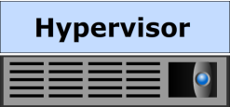
Configuration Monitoring Example
VM Configuration
Consumer Organization 1
Consumer Organization 2
Consumer Organization 3
Consumer Organization 4
Configuration Policy
Condition 1: | Generate warning for the security event
Condition 2: | Access this computer from the network
Condition 3: | Adjust memory quotas for a process
Condition 4: | Always prompt client for password upon connection
• | •
• | •
Condition 27: | Allow automatic administrative logon
Compute Pool
Compliance Result
Object Type
Number of Objects
Number of Conditions
Compliant Conditions
Non-compliant Conditions
Virtual Machine
9
27
6
22%
78%
21
Notes:
This example illustrates the importance of monitoring the configuration of services and their compliance to configuration policies.
The figure on the slide illustrates a cloud environment that provides services to four consumer organizations. For each consumer organization one or more VMs are deployed to provide service. These VMs are provisioned by allocating resources from a compute pool. The service provider needs to ensure that the configuration of these VMs are compliant to a configuration policy related to system security. The configuration policy includes 27 conditions. VMs are compliant to the configuration policy if all conditions in the policy are compliant to the existing configuration of VMs.
The monitoring tool verifies VM configuration against the configuration policy and provides the compliance results. The result shows that 22 percent of the evaluated conditions in the policy are compliant or passed against the existing configuration of VMs and 78 percent are not compliant or failed. This result helps the cloud administrators to assess compliance to configuration policy and to take necessary action to ensure compliance.

Slide 33
Availability Monitoring
Track the availability of services and infrastructure components during their intended operational time
Availability monitoring examples:
Identifying failure of an infrastructure component
Identifying failing services
Notes:
Availability monitoring involves tracking availability of services and infrastructure components during their intended operational time. It helps to identify a failure of any component that may lead to service unavailability or degraded performance. Availability monitoring also helps an administrator to proactively identify failing services and plan corrective action to maintain SLA requirements.

Slide 34
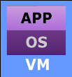
Availability Monitoring Example
Compute System Failure
Service
Migrated VMs
VM Failover
Utilization of Compute System B
100%
Compute System A
Compute System B
80%
0%
Hypervisor Cluster with Dynamic VM Failover
No Redundancy due to Compute System A Failure
High Utilization may Degrade Service Performance
→ Inaccessible
Notes:
This example illustrates the importance of monitoring the availability of the cloud infrastructure components.
Consider an implementation in a cloud infrastructure with two compute systems (compute system A and compute system B) and a storage system interconnected through a VLAN. Both the compute systems are running hypervisors and are member of the cluster formed by the hypervisors. During normal condition, a total of six VMs are hosted on the hypervisor cluster – three on each compute system. These VMs are components of a cloud service. Dynamic failover of VMs is enabled for the hypervisor cluster.
If compute system A fails, VMs running on it automatically failover to compute system B and consumers continue to access services. However, due to the absence of redundant compute system, failure of compute system B could result in unavailability of services. Further, because all VMs are hosted on a single compute system, the utilization of compute system B reaches 80 percent, which may degrade service performance.
A monitoring tool detects the compute system failure and notifies cloud administrators to take corrective action before another failure occurs. In most cases, the monitoring tool provides symptom notifications for a failing component to the administrators so as to initiate actions before the component fails.

Slide 35
Capacity Monitoring
Tracks the amount of cloud infrastructure resources used and available
Capacity monitoring examples:
Examining used and unused capacity available in a resource pool
Examining utilization of capacity by service instances
Tracking capacity limit for each service
Tracking dynamic allocation of storage capacity to thin LUNs
Tracking over-commitment of memory and processor cycles
Notes:
Capacity monitoring involves tracking the amount of cloud infrastructure resources used and available. It ensures the availability of sufficient resources and prevents service unavailability or performance degradation. It examines the used and unused capacity available in a resource pool, the utilization of capacity by service instances, the capacity limit for each service, dynamic allocation of storage capacity to thin LUNs, over-commitment of memory and processor cycles, and so on. Capacity monitoring ensures uninterrupted service availability and scalability by averting outages before they occur. Further, capacity monitoring helps to perform capacity trend analysis. This analysis helps in understanding future resource requirements and planning for procuring resources on time.

Slide 36

Capacity Monitoring Example
Storage Pool Space
Notification: Pool is 80% Full
Pool Expanded
Notification: Pool is 66% Full
Available Capacity
Available Capacity
Available Capacity
Available Capacity
Used Capacity
Used Capacity
Used Capacity
Used Capacity
Disk Drives
Storage Pool
Storage Pool
Storage Pool
Storage Pool
Time
Disk Drives
Notes:
This example illustrates the importance of monitoring the storage pool space (used and available) in a cloud infrastructure.
The figure on the slide illustrates a storage pool created from a collection of physical disk drives. Storage volumes are provisioned from the storage pool to each consumer of a storage service. When the pool is full and no storage space is available to the consumers, it results in service outage.
Monitoring tools can be configured to issue a notification when thresholds are reached on the storage pool capacity. For example, when the storage pool reaches 66 percent of its capacity, a notification is issued; likewise, another notification is issued when the pool reaches 80 percent of its capacity. This enables the administrators to take action to extend the storage pool by adding more disk drive to it before it runs out of capacity. This way proactively monitoring can prevent service outage caused due to lack of space in a storage pool.

Slide 37
Performance Monitoring
Evaluates how efficiently different services and infrastructure components are performing
Performance monitoring examples:
Examining response time and throughput of services and infrastructure components
Identifying performance bottlenecks
Tracking performance trends of infrastructure components
Synthetic monitoring
Notes:
Performance monitoring evaluates how efficiently different services and infrastructure components are performing. It examines performance metrics such as response time, throughput, I/O wait time, and processor utilization of services and infrastructure components. This helps to identify performance bottlenecks. Performance monitoring also helps in analyzing the performance trends of infrastructure components and finding potential performance degradation or failure of a service.
Synthetic monitoring can provide an organization the ability to perform deep transactional monitoring from a consumer’s perspective, looking beyond the availability and performance of the constituent elements such as processor, memory, and storage of a cloud service. For example, a monitoring agent external to the cloud might simulate or perform a set of transactions against a cloud service, such as searching an online store for an item, adding it to a shopping cart and then checking out, to ensure that the service is functioning within the desired operating parameters. This can provide end-to-end visibility into the availability and performance of the cloud service and provide early insight into any issues, enabling remediation before an issue impacts the service itself.

Slide 38

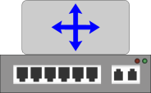

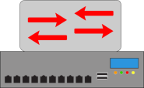
Performance Monitoring Example
Processor Utilization
Internet
IP Router
Firewall
VLAN 10
Load Balancers
VLAN 20
Web Servers
100%
VLAN 30
Application Server
Processor Utilization %
VLAN 40
Database Server
8 AM
11 AM
2 PM
Service
Time
Notes:
This example illustrates the importance of monitoring performance of a service.
In this context, a service comprises below elements:
2 web servers
1 application server
1 database server
2 load balancers distributing clients connections across web servers
1 IP router enabling network address translation (NAT)
1 firewall filtering client traffic from Internet to the web servers
VLAN 10, 20, 30, 40 interconnecting above elements as shown in the figure
A synthetic monitoring reveals that the throughput of the service has drastically dropped since 8 AM. The monitoring tool deployed at provider’s premises shows that at about same time the utilization of processor at the database server has started raising and is nearing 100 percent. However, the utilization of other elements of the cloud service is normal. This clearly indicates that the database server is the performance bottleneck. The monitored information enables the cloud administrators to take action to increase processing power of the VM providing database service before consumers report performance issues.

Slide 39
Security Monitoring
Tracks unauthorized access and configuration changes to the cloud infrastructure and services
Security monitoring example:
Detecting operations and data movement that violate security policies
Tracking service unavailability due to security breaches
Checking physical security
Notes:
Security monitoring tracks unauthorized access and configuration changes to the cloud infrastructure and services. It detects all service-related operations and data movement that deviate from the security policies implemented and included in the service contract by the provider. Security monitoring also detects unavailability of services to authorized consumers due to security breaches. Physical security within the cloud service provider’s premises should also be continuously monitored using appropriate technologies such as badge readers, biometric scans, and video cameras.

Slide 40






Security Monitoring Example
Sensitive Data Leaking
Non-compliant Content Blocked
Community Cloud
Compliant Content Allowed
Internet
Network Monitoring and Analysis System
Partner Site
Security Events
Event ID
Date
Severity
User
Violated Policy
Policy Action
179
12/06/2014, 02:14 PM
High
Corporate\M. Stephen
User Account Information
Block
178
12/06/2014, 10:55 AM
High
Corporate\Administrator
PCI-DSS
Block
177
12/06/2014, 10:54 AM
Critical
Corporate\Administrator
Key Employee Data
Block
176
11/06/2014, 06:15 PM
Low
Corporate\L. John
Enterprise’s Intellectual Property
Block
Notes:
This example illustrates the importance of monitoring security in a cloud environment.
The figure shows a community cloud infrastructure at a provider’s premises. The community cloud provides service to the provider’s organization as well as a partner site. All network traffic between the cloud infrastructure and the partner site is transferred over the Internet. This environment poses risk of malicious or unintended transfer of provider’s sensitive data such as user account information, credit card data, key employee data, and organization’s intellectual property to the partner site.
A network monitoring and analysis system deployed at the provider’s infrastructure can mitigate the risk of sensitive data leakage. It monitors and analyzes the content of all network traffic transferred through a network link and blocks traffic that is not compliant to the applicable security policy. It also shows security events (shown in the table) by listing the date of violation, severity of event, name of the user who violated the policy, violated policy name, and any action taken to prevent the data leaking. If the security events are not monitored or recorded, it is difficult to track such violations of security policy. Conversely, if these events are monitored, notifications can be sent to prompt appropriate administrative action, to educate users on policy violation, or at least to enable discovery as part of regular auditing operations.

Slide 41
Alerting
Alerts are system-to-provider/consumer notifications
Provide information about events or impending threats or issues
Trigger when specific situations or conditions are reached
Conditions may be defined through monitoring tools
Help administrator to respond to service-related issues proactively
Type of Alert | Examples
Informational | A new service has been created Service instance is ready to use
Warning | Resource pool is at 85% utilization File system is becoming full Consumer is approaching resource usage limit
Fatal | Service is failed SLA is violated
Notes:
An alert is a system-to-provider (and sometimes consumer) notification that provides information about an event or impending threats or issues. Alerting is based on monitoring and is triggered when a specific situation or condition is reached. These conditions may be defined by cloud administrators through monitoring tools that generate alerts based on the identified conditions. Alerting keeps administrators and consumers informed about the status of various services, infrastructure components, and service-related processes. It also helps administrators respond to service-related issues quickly and proactively. Consider an example: a condition such as degraded performance of a data center or site (also called a service availability zone) providing a service in a multi-zone cloud environment may trigger an alert message, indicating a need for administrative intervention. Other examples, such as a resource pool having reached a capacity threshold, a service operation having breached a security policy, or a consumer having violated an SLA term may also be indicated via alerts.
Alerts may be classified as informational, warning, or fatal based on their severity level. Informational alerts provide useful information but may not require any intervention by the administrators or consumers. Warning alerts require attention so that the alerted condition is contained and does not affect service availability and performance in the future. Fatal alerts require immediate attention because the condition might affect the performance and availability of a cloud service. The table on the slide describes the examples of different types of alerts.
As every IT environment is unique, most monitoring systems require initial set-up and configuration, including defining what types of alerts should be classified as Informational, Warning, and Fatal. Whenever possible, the provider should limit the number of truly critical alerts so that important events are not lost amidst informational messages. In some cases, recovery actions may be configured to automatically correct common events. For example, monitoring may be set up to automatically provision additional storage in the event that a file system is nearing its capacity.

Slide 42
Reporting
Reports are formulated from data gathered through monitoring
Provide current status and historical trends about configuration, connectivity, capacity, performance, utilization, or billing
Reports are usually visible through cloud portal and management software interface
Displays reports like a digital dashboard
Provides real time tabular or graphical views of monitored information
Notes:
Reports are formulated from the configuration, availability, capacity, performance, and security data gathered as a result of monitoring. They may provide current status and historical trends about configuration, connectivity, capacity, performance, resource usage, service cost, or billing. They are usually visible through cloud portal and management software interface.
Reports are commonly displayed like a digital dashboard, which provide real time tabular or graphical views of monitored information. Dashboard reporting helps cloud service providers to make instantaneous and informed decisions on resource procurement, plans for modifications in the existing infrastructure, and improvements in service management processes. In other words, dashboard reporting is a critical component of both portfolio and operation management. Reports may also be made available to consumers, enabling them to view service usage and bills.

Slide 43
Common Report Types
Report Type | Description
Service usage | Amount of resources consumed per consumer per service instance
Consumption vs. contracted limits | Resources used compared to resources purchased
SLA compliance | Service availability and performance compared to SLA
Security violations | Listed violations, duration, data loss, and impact
Operational activity audit log | Time stamped log of service transactions
Notes:
The table on the slide describes some common report types.

Slide 44
Lesson Summary
During this lesson the following topics were covered:
Configuration monitoring
Availability monitoring
Capacity monitoring
Performance monitoring
Security monitoring
Alerting and reporting
Notes:
This lesson covered configuration monitoring, availability monitoring, capacity monitoring, performance monitoring, security monitoring, alerting, and reporting.

Slide 45
Lesson: Service Operation Management – III
This lesson covers the following topics:
Service asset and configuration management
Change management
Capacity management
Performance management
Notes:
This lesson covers service asset and configuration management, change management, capacity management, and performance management.

Slide 46
Service Asset and Configuration Management
Goal
Maintain information on “configuration items (CIs)” and their relationships. CIs are components such as services, process documents, infrastructure components, people, and SLAs that need to be managed in order to deliver services.
CI’s name
Manufacturer name
Serial number
License status
Version
Location
Inventory status
Maintains information about:
Attributes of CIs
Used and available capacity of CIs
Issues linked to CIs
Inter-relationships among CIs
Notes:
The goal of service asset and configuration management is to maintain information on configuration items (CIs) and their relationships. CIs are components such as services, process documents, infrastructure components including hardware and software, people, and SLAs that need to be managed in order to deliver services. The key functions of service asset and configuration management are described below:
Service asset and configuration management team maintains information about CI attributes such as the CI’s name, manufacturer name, serial number, license status, version, description of modification, location, and inventory status (e.g., on order, available, allocated, or retired). Along with these attributes, it keeps information on used and available capacities of CIs and any issues linked to the CIs. Further, it maps and maintains information on the inter-relationships among CIs. Such relationships in a cloud infrastructure commonly include service-to-consumer, VM-to-service, compute resource pool-to-VM, physical compute system-to-compute resource pool, physical compute system-to-network switch, and data center-to geographic location. This mapping ensures that CIs are viewed as integrated components. A consolidated view of CIs helps in the process of identifying the root cause of issues in the cloud infrastructure and services and in assessing the impact of any change in relationships. For example, when a switch fails, administrators of the provider’s organization get an automated alert from the service management tools about other CIs that are affected by that outage. Similarly, when administrators decide to increase the capacity of a storage pool, they can easily identify the CIs affected by the change.
(Cont'd)

Slide 47
Service Asset and Configuration Management (Cont'd)
Maintains information in a single database or a federated database called configuration management system (CMS)
Provides a single view about CI attributes and their relationships
Other service management processes use information from CMS
CMS is usually populated by discovery tools
Updates CMS when new CIs are deployed or CI attributes change
Checks veracity and currency of information about CIs periodically
Notes:
Service asset and configuration management team is responsible for maintaining all information about CIs in a single database or in multiple autonomous databases mapped into a federated database called a configuration management system (CMS). The federated database bridges information from multiple autonomous databases to provide a single view about the CI attributes and their relationships across even very large infrastructures. Other service management processes interact with the CMS to view the relationships between CIs and to track their configurations. This interaction, for example, helps another process to examine the deployment of a security patch, resolve an issue in the cloud infrastructure, or to determine required changes in a service. The CMS is usually populated by discovery tools that automatically gather information on CIs. Discovery tools also update the CMS when new CIs are deployed or when attributes of CIs change. Further, these tools periodically check the veracity and currency of information about CIs to ensure that the information maintained in the CMS is an exact representation of the CIs used to provide cloud services.
Note: Some readers may be more familiar with the term configuration management database (CMDB) rather than CMS regarding configuration management. CMDB is a single repository to store configuration records as opposed to a federated database that is more common in the cloud environment.

Slide 48
Change Management
Goal
Standardize change-related procedures in a cloud infrastructure for prompt handling of all changes with minimal impact on service quality.
Low risk and routine changes may be approved automatically
Helps in meeting cloud rapid deployment, elasticity, and SLA
Orchestrator monitors compliance to predefined change policies
Compliant requests are exempted from change management review
Other changes are reviewed by a change advisory board (CAB)
Assess potential risk of change, prioritize, and make a decision
Collaborate remotely through web-based tools to respond quickly
Notes:
The goal of change management is to standardize change-related procedures in a cloud infrastructure for prompt handling of all changes with minimal impact on service quality. A good change management process enables the cloud service provider to respond to the changing business requirements in an agile way and greatly minimizes risk to the organization and its services.
Relevant changes could range from the introduction of a new service offering, to modification of an existing service’s attributes, to retirement of a service; from a hardware configuration change, to expansion of a resource pool, to a software upgrade, and even to a change in process or procedural documentation. Change management oversees all changes to CIs to minimize adverse impact of those changes to the business and the consumers of cloud services.
Drivers and causes of changes in cloud infrastructure and services can be as varied as the range of changes themselves. There may be a need to improve service, to mitigate the impact of specific problems, to meet compliance or regulatory requirements, to address a modification in an SLA, or to accommodate revised business objectives.
(Cont'd)

Slide 49
Change Management
Goal
Standardize change-related procedures in a cloud infrastructure for prompt handling of all changes with minimal impact on service quality.
Low risk and routine changes may be approved automatically
Helps in meeting cloud rapid deployment, elasticity, and SLA
Orchestrator monitors compliance to predefined change policies
Compliant requests are exempted from change management review
Other changes are reviewed by a change advisory board (CAB)
Assess potential risk of change, prioritize, and make a decision
Collaborate remotely through web-based tools to respond quickly
Notes:
The key functions of change management are described below:
Potential changes in the cloud infrastructure and services may have different risk profiles (impact and urgency). For changes that are low risk and routine, there may be a business decision to allow automated approval. The automated approval helps in meeting cloud rapid deployment, elasticity, and SLA requirements. To automate the approval process, change policies are defined in the cloud environment and orchestrator monitors compliance to these policies. The orchestrator collects and process requests for change through a change approval and execution workflow. It enables compliant requests to go through the change management process only once to determine that they can be exempted from change management review thenceforth. After that, these requests are typically treated as service requests and approved automatically.
Although there are some changes that occur so frequently and with such low risk to the business that they can be effectively treated as service requests (to be agreed by the change management process), all other changes are presented for review to a change advisory board (CAB) that exists within the provider organization. CAB members have the necessary technical and business acumen to assess the potential risk of the change, prioritize, and make a decision on the requested change. To minimize the impact on consumer experience, resources subject to a change approval may even be provisioned while the CAB members are following through with the approval process. CAB members usually collaborate remotely through web-based tools to assess the impact of a change, to identify potential conflict after a change, and to vote for or against a change. This ensures quick response to the request for change, minimizes risk, and avoids rework or degradation of service quality. Change management tools also facilitate coordination, tracking, and reporting on change implementation.

Slide 50
Capacity Management
Goal
Ensure that a cloud infrastructure is able to meet the required capacity demands for cloud services in a cost effective and timely manner.
Determines optimal amount of resources needed for service
Meets dynamic consumption and peak demands for resources
Maximizes capacity utilization without impacting service levels
Common Methods to Maximize Capacity Utilization
Resource pooling
Over-commitment of processor cycles and memory
Automated VM load balancing across hypervisors
Dynamic scheduling of virtual processors across processing cores
Thin provisioning
Automated storage tiering
Dynamic VM load balancing across storage volumes
Converged network
WAN optimization
Automatic reclamation of capacity when a service is terminated
Notes:
The goal of capacity management is to ensure that a cloud infrastructure is able to meet the required capacity demands for cloud services in a cost effective and timely manner. Capacity management helps ensure that peak demands from consumers can be met without compromising SLAs and at the same time optimizes capacity utilization by minimizing spare and stranded capacity. The key functions of capacity management are described below:
Capacity management team determines the optimal amount of resources required to meet the needs of a service regardless of dynamic resource consumption and seasonal spikes in resource demand. With too few resources, consumers may have to wait for resources to free up or their requests may be rejected until additional resources are available in the cloud. With too many resources, the service cost may rise unnecessarily due to maintenance of many unused, spare resources. Effective capacity planning maximizes the utilization of available capacity without impacting service levels. The slide provides a list of common methods to maximize capacity utilization.
(Cont'd)

Slide 51
Capacity Management (Cont'd)
Plans current and future infrastructure capacity requirements
Gathers historical information on resource usage
Establishes capacity consumption trends
Performs predictive analysis of future demands
Plans for procurement and provisioning of additional capacity
In most cost effective and least disruptive manner
Notes:
Capacity management team plans both current and future infrastructure capacity requirements. Capacity management tools are usually capable of gathering historical information on resource usage over a specified period of time, establishing trends on capacity consumption, and performing predictive analysis of future demand. This analysis serves as input to the capacity planning activities and enables the procurement and provisioning of additional capacity in the most cost effective and least disruptive manner.

Slide 52
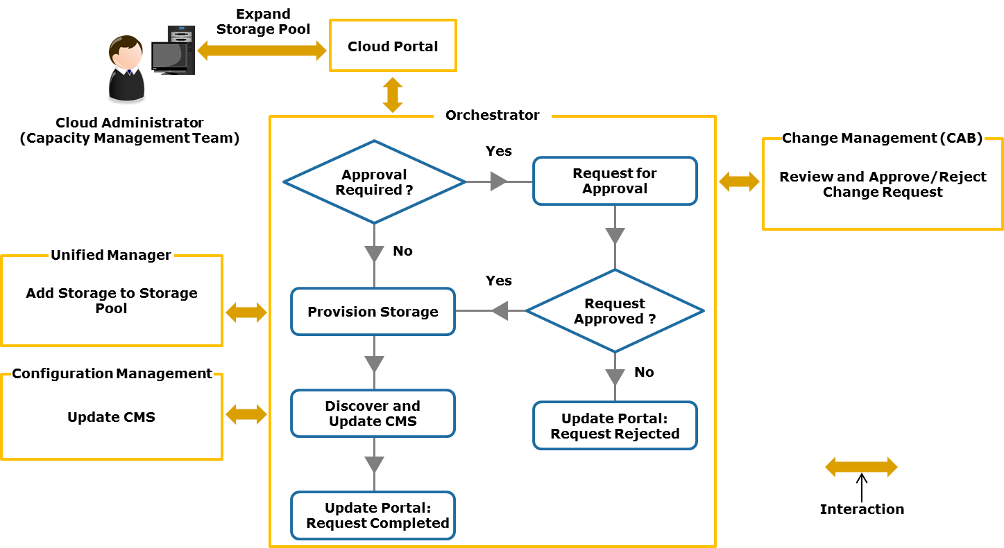
Example: Expanding Storage Pool Capacity
Notes:
This example illustrates the expansion of a storage pool to respond quickly to the needs of a provider and consumers using an orchestrated workflow.
An administrator of capacity management team requests for additional storage to a storage pool (see figure on the slide) through the cloud portal. The request is transferred to the orchestrator that triggers a change approval and execution workflow. The orchestrator determines whether the request for change needs to be reviewed by change management team (CAB). If the request is preapproved, it is exempted from change management review. If not, the orchestrated workflow ensures that the change management team reviews and approves/rejects the request.
If the request is approved by the change management team, a resource provisioning request is sent to the unified manager. The unified manager interacts with element manager to provision required storage to the storage pool. The orchestrated workflow also initiates the discovery of additional storage in the pool. Upon discovery, the CMS is updated with information about modified pool capacity. The orchestrator responds by sending updates to the cloud portal appropriately following completion or rejection of the request for expanding the storage pool.

Slide 53
Performance Management
Goal
Monitor, measure, analyze, and improve the performance of cloud infrastructure and services.
Monitors and measures performance of infrastructure components and service instances using tools
Detects components and instances performing below expectation
Identifies potential performance issues and prescribes actions
Makes changes before performance issues impact consumers
Examples of Performance-related Changes
Allocating more memory to VMs running cloud management software
Migrating a service to a different availability zone
Moving application instances to a public cloud in a hybrid cloud environment
Changing policy for balancing client workload across servers
Notes:
The goals of performance management are to monitor, measure, analyze, and improve the performance of cloud infrastructure and services. The key functions of performance management are described below:
Performance management team uses specialized management tools that monitor and measure performance metrics of the cloud infrastructure components and service instances, such as response time and data transfer rate. These tools analyze the performance statistics and detect components and service instances that are performing below the expected levels. They proactively alert administrators about potential performance issues and may prescribe a course of action to improve a situation.
Administrators of performance management team implement changes before consumers are impacted by performance issues in the cloud environment. Some of the examples of changes that may be implemented in order to maintain needed performance levels are listed on the slide.
(Cont'd)

Slide 54
Performance Management (Cont'd)
Determines the required capacity of resource pools to meet the expected performance level
Works with capacity management to implement needed changes
Defines strategies to meet or exceed the required performance level
Examples of Performance Management Strategies
Policy-based placement of VMs across clustered hypervisors
Quality of service (QoS) networking
Automated storage tiering
Cache tiering
Notes:
Overutilization of resource pools is a key reason for performance degradation. Performance management team determines the required capacity of the resource pools to meet the expected performance levels. It works together with capacity management team to implement the changes related to capacity and performance.
Performance management team ensures that all infrastructure components are meeting or exceeding the required performance levels. To maintain the agreed performance level, administrators may define strategies for policy-based placement of VMs across clustered hypervisors, quality of service (QoS) networking, automated storage tiering, and cache tiering, as several examples.

Slide 55
Lesson Summary
During this lesson the following topics were covered:
Service asset and configuration management
Change management
Capacity management
Performance management
Notes:
This lesson covered service asset and configuration management, change management, capacity management, and performance management.

Slide 56
Lesson: Service Operation Management – IV
This lesson covers the following topics:
Incident management
Problem management
Availability management
Information security management
Notes:
This lesson covers incident management, problem management, availability management, and information security management.

Slide 57
Incident Management
Goal
Return cloud services to consumers as quickly as possible when unplanned events, called ‘incidents’, cause an interruption to services or degrade service quality.
Detects and records all incidents in the cloud infrastructure
Incident management tools proactively recognize specific event(s) as incidents and log incidents
Incidents are registered by consumers through cloud portal/email
Incidents are reported by consumers through a service desk
Provides first line of service support
Notes:
The goal of incident management is to return cloud services to consumers as quickly as possible when unplanned events, called incidents, cause an interruption to services or degrade the service quality. An incident may not always cause service failure; for example, the failure of a disk from a mirrored set of RAID protected storage does not cause data unavailability. However, if not addressed, recurring incidents may cause service interruption in the future. The key functions of incident management are described below:
The incident management process detects and records all incidents in the cloud infrastructure. Cloud service providers usually deploy incident management tools that enable cloud administrators to manage and track the incidents from their initiation to closure. These tools may proactively recognize specific event(s) in the cloud infrastructure as incidents and automatically log them for resolution. They automatically respond to, resolve, and escalate incidents. Incidents may also be registered by the consumers through the cloud portal or by email. Additionally, incidents may be reported by consumers through a service desk. The service desk may consist of a call center to handle a large volume of telephone calls and a help desk as the first line of service support.
Upon initial report of an incident to the service desk, it attempts to resolve the incident by consulting the known error database and the CMS. Known errors are common issues or incidents experienced by consumers for which solutions or workarounds have already been defined. The known error database helps the service desk to execute the necessary technical actions to more quickly restore a failed or degraded service. If the service desk is unsuccessful in providing solutions against the incidents, they are escalated to other incident management support groups or to problem management (described next).
(Cont'd)

Slide 58
Incident Management (Cont'd)
Investigates incidents escalated by incident management tool and service desk and identifies appropriate solutions
Incident management team consists of multiple support groups that resolve incidents within agreed timeframe specified in SLA
Transfers error-correction activity to “Problem Management”, if unable to correct the “root cause” of an incident
In this case, provides a temporary solution to the incident
Tracks service degradation period/downtime to check for SLA violations
Documents incident history used as input for “Problem Management”
Notes:
The incident management team investigates the incidents escalated by the incident management tool and the service desk. It identifies appropriate solutions to resolve the incidents. The incident management team usually consists of multiple support groups, such as first and second levels. Incident tracking, assignment to appropriate personnel, status update, and escalation across these groups are automated through incident management tool. First level support specialists are capable of addressing most of the common incidents. If they are unable to do so, they quickly escalate the incidents to the second level technical experts and the process continues until the incident is resolved. The exact number of support groups depends on provider’s service management structure, but irrespective of the number, incident management should provide solutions to bring back cloud services within an agreed timeframe specified in the SLA.
If incident management team is unable to determine and correct the root cause of an incident, error-correction activity is transferred to problem management. In this case, it provides a temporary solution (workaround) to the incident; for example, migration of a cloud service to a different resource pool in the same data center or in a different data center. During the incident resolution process, the consumer is kept apprised of the incident status.
Incident management tools also track the period of service degradation and downtime to check for SLA violations. If a violation occurs, adjustments may be made to billing, based on the service contract. In some instances, even with an SLA calling for compensation for outages or unavailability, the service provider may elect to pursue billing adjustments only when the consumers bring SLA violations to its attention and that violation can be proved to be the service provider’s fault.
Incident management team documents the incident history with details of the incident symptoms, affected services, components and consumers, time to resolve the incident, severity of the incident, description of the error, and the incident resolution data. The incident history is used as an input for problem management.

Slide 59
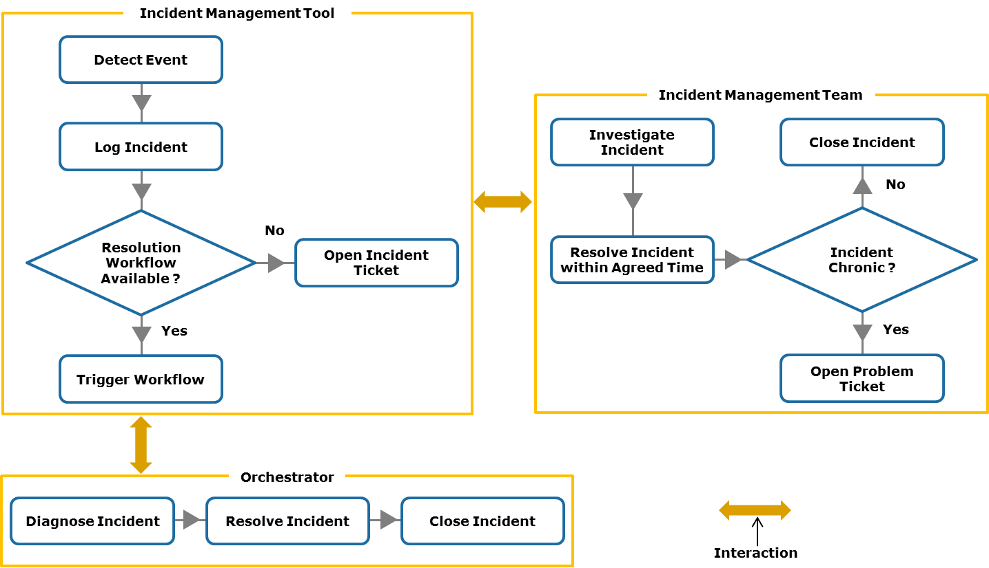
Example: Resolving an Incident
Notes:
This example illustrates the resolution of an incident detected by an incident management tool deployed in the cloud infrastructure. The tool recognizes an event related to a cloud service as an incident and automatically logs it for resolution. If an orchestrated workflow exists to resolve the incident, the incident management tool triggers the workflow through interaction with orchestrator. The workflow enables diagnostics and remedial procedure to address the incident. If no such workflow exists to resolve this incident, the incident management tool opens an incident ticket and assigns the incident resolution activity to the incident management team.
Administrators of incident management team investigate the reason(s) that cause the incident and resolve the incident by providing appropriate solution within an agreed timeframe specified in the SLA. Further, if the incident is chronic or is a recurring issue, the incident management team turns it over to problem management for further analysis. Otherwise, the incident management team closes the incident.

Slide 60
Problem Management
Goal
Prevent incidents that share common symptoms or—more importantly—root causes from reoccurring, and to minimize the adverse impact of incidents that cannot be prevented.
Detects problems and identifies underlying root cause that creates a problem
Uses integrated incident and problem management tools for:
Administrators to track and mark specific incident(s) as a problem
Automatic identification of incidents to require root cause analysis
Automatic discovery of root cause through correlation of alerts
Notes:
The goal of problem management is to prevent incidents that share common symptoms or—more importantly—root causes from reoccurring, and to minimize the adverse impact of incidents that cannot be prevented. A problem is recognized when multiple incidents exhibit one or more common symptoms. Problems may also be identified from a single significant incident that is indicative of a single error for which the cause is unknown, but the impact is high. The key functions of problem management are described below:
The problem management process detects problems and ensures that the underlying root cause that creates a problem is identified. Incident and problem management, although separate service management processes, require automated interaction between them and use integrated incident and problem management tools. These tools may help an administrator to track and mark specific incident(s) as a problem and transfer the matter to problem management for further investigation. Alternatively, these tools may automatically identify incidents that are most likely to require root cause analysis. Further, these tools may have analytical ability to perform root cause analysis based on various alerts. They search alerts that are indicative of problems and correlate these alerts to find the root cause. This helps to resolve problems more quickly.
(Cont'd)

Slide 61
Problem Management (Cont'd)
Handles problems both reactively and proactively
Reactive problem management:
Identifies problems by reviewing incident history
Prioritizes problems based on impact to the business and the consumers
Identifies and investigates root cause and provides solution
Proactive problem management:
Proactively analyzes errors and alerts
Identifies impending service failures or quality degradation
Identifies and solves errors before problems occur
Records resolved problems to known error database
Helps in resolving future incidents and problems
Notes:
Problem management team minimizes the adverse impact of incidents and problems caused by errors in the cloud infrastructure and initiates actions to prevent recurrence of incidents related to those errors. Problem handling activities may occur both reactively and proactively. These are described below:
Reactive problem management: It involves a review of all incidents and their history for problem identification. It prioritizes problems based on their impact to business and consumers. It identifies and investigates the root cause that creates a problem and initiates the most appropriate solution and/or preventive remediation for the problem. It also reviews the known error database to find out if the problem has occurred in the past and if a resolution is already in place. If complete resolution is not available, problem management provides solutions to reduce or eliminate the impact of a problem.
Proactive problem management: It helps prevent problems. By proactively analyzing errors and alerts in the cloud infrastructure and identifying impending service failures or quality degradation, problem management team identifies and solves errors before a problem occurs. By preventing problems, instead of just reacting to them, the problem management function reduces the number of incidents and potential SLA violations.
Problem management is responsible for creating the known error database. After problem resolution, the issue is analyzed and a determination is made whether to add it to the known error database. Inclusion of resolved problems to the known error database provides an opportunity to learn and better handle future incidents and problems.

Slide 62
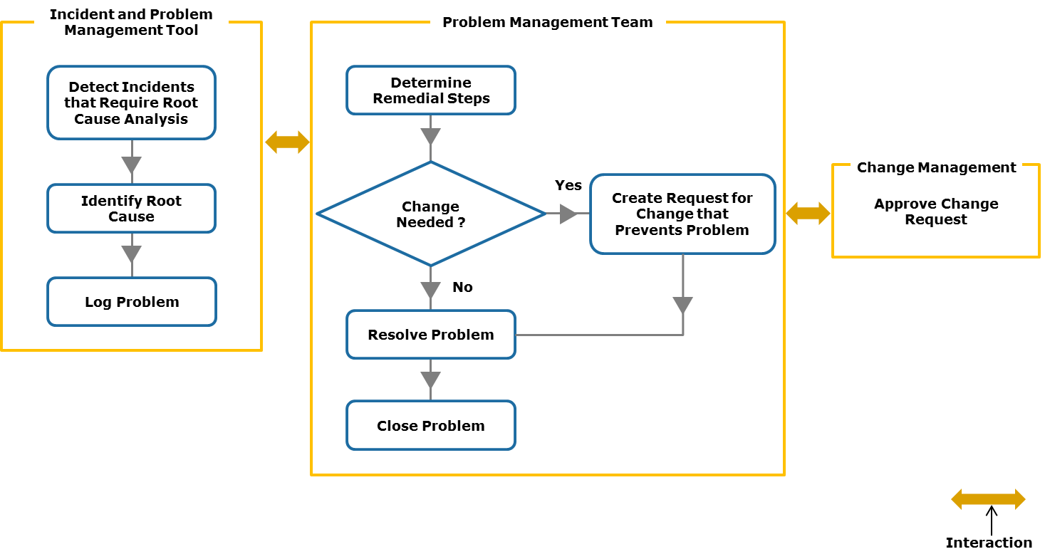
Example: Resolving a Problem
Notes:
This example illustrates reactive problem management. It resolves a problem recorded by an integrated incident and problem management tool deployed in the cloud infrastructure.
The incident and problem management tool automatically identify incidents that are most likely to require root cause analysis. It performs root cause analysis by correlating various alerts across all components of the cloud infrastructure. This helps a cloud administrator to quickly identify the root cause of incidents, symptoms of the issue, and the impacted components and services. The incident and problem management tool also logs a problem for administrative action.
Administrators of the problem management team can view the problem details including root cause recorded by the incident and problem management tool. They determine the remedial steps to correct the root cause. If the root cause can be prevented by a change in the cloud infrastructure, they create a request for change for change management approval. Upon obtaining the approval, they ensure that the change is implemented. Once an appropriate solution is implemented to remediate the root cause, the problem management team closes the problem.

Slide 63
Availability Management
Goal
Ensure that stated availability commitments are consistently met.
Gathers information on availability requirements for upgraded and new services
Monitors availability of existing services and components
Tools identify gap between committed and achieved availability
Interacts with incident and problem management teams
Gets input on causes of service failure and faults in components
Identifies new availability needs and areas for improvement
Notes:
The goal of availability management is to ensure that the stated availability commitments are consistently met. The availability management process optimizes the capability of cloud infrastructure, services, and the service management team to deliver to consumers a cost effective and sustained level of service that meets SLA requirements. The key functions of availability management are described below:
The availability management team gathers information on the availability requirements for upgraded and new services. Different types of cloud services may be subjected to different availability commitments and recovery objectives. A provider may also decide to offer different availability levels for same type of services, creating tiered services.
The availability management team proactively monitors whether availability of existing cloud services and infrastructure components is maintained within acceptable and agreed levels. The monitoring tools identify differences between the committed availability and the achieved availability of services and notify administrators through alerts.
Availability management team interacts with incident and problem management teams, assisting them in resolving availability-related incidents and problems. Through this interaction, incident and problem management teams provide key input to the availability management team regarding the causes of service failures. Incident and problem management also provide information about errors or faults in the infrastructure components that may cause future service unavailability. With this information, the availability management team can quickly identify new availability requirements and areas where availability must be improved.
(Cont'd)

Slide 64
Availability Management (Cont'd)
Analyzes, plans, designs, and manages procedures and technical features to meet availability needs at a justifiable cost
Proposes changes in the existing business continuity (BC) solutions or architects new BC solutions
Ensures that deployed BC solutions are tested regularly
Examples of Business Continuity Solutions
Clustering of compute systems to provide automated service failover
Replicating a database and hypervisor’s native file system continuously
Deploying multiple availability zones, enabling automated service failover globally
Creating redundant network links between devices, sites, and clouds in a hybrid cloud
Notes:
The availability management team analyzes, plans, designs, and manages the procedures and technical features required to meet or exceed both current and future availability needs of services at a justifiable cost. Based on the SLA requirements of enhanced and new services, and areas found for improvement, the administrators of availability management team may suggest changes in the existing business continuity (BC) solutions or architect new solutions that provide additional tolerance and resilience against service failures. The availability management team also ensures that the deployed BC solutions are tested regularly. The slide provides examples of BC solutions that could be proposed by the availability management team.
While the primary goal of availability management is to ensure that service availability meets SLA commitments, it provides additional benefits, such as reducing the time consumers spend with the service desk addressing outages, improving consumer satisfaction, and consequently lifting the cloud service provider’s reputation. With a reduction in the frequency and duration of availability related incidents and problems, fewer staff members are required to handle incident and problem management functions, reducing the cloud service provider’s operational costs.

Slide 65
Information Security Management
Goal
Prevent the occurrence of incidents or activities adversely affecting the confidentiality, integrity and availability of information in cloud services and all service management processes.
Protect corporate and consumer data to the extent required to meet the regulatory or compliance concerns (both internal and external), and at reasonable/acceptable costs.
Develops information security policies that govern the provider’s approach towards information security management
Security assurances are often detailed in SLAs and contracts
Policies are reviewed periodically and, as necessary, are modified
Notes:
The goal of information security management is to prevent the occurrence of incidents or activities adversely affecting the confidentiality, integrity, and availability of information in cloud services and all service management processes. Protecting corporate and consumer data to the extent required to meet regulatory or compliance concerns (both internal and external), and at reasonable/acceptable costs are additional goals of information security. The interests of all stakeholders of a cloud service, including consumers who rely on information and the IT infrastructure, are considered. The key functions of information security management are described below:
Information security management team implements the cloud service provider’s security requirements. It develops information security policies that govern the provider’s approach towards information security management. These policies may be specific to a cloud service, an external service provider, an organizational unit, or they can be uniformly applicable. Information security policies must be approved by top executive management. These security assurances are often detailed in SLAs and contracts. Information security management requires periodic reviews and, as necessary, revision of these policies.
(Cont'd)

Slide 66
Examples of Information Security Policy
Overall information security policy including physical location of data
Access control policy
Password control policy
Malware protection policy
Remote access policy
Physical and environmental security policy
Policy with regard to supplier access to service assets and information
Service asset disposal policy
Policy for encrypting data during transmission and at rest
Policy for maintaining multiple service availability zones
Notes:
The slide provides examples of information security policy developed by information security management team.
(Cont'd)

Slide 67
Information Security Management (Cont'd)
Establishes a security management framework aligned with security policies that specifies:
Security architecture
Security processes
Security mechanisms
Security tools
Responsibilities (consumers and cloud administrators)
Required security standards
Ensures that security processes and mechanisms articulated in the framework are properly implemented
Notes:
Information security management team establishes a security management framework aligned with the security policies. The framework specifies security architecture, processes, mechanisms, tools, responsibilities (for both consumers and cloud administrators), and standards needed to ensure information security in a cost-effective manner. The security architecture describes the structure and behavior of security processes, methods of integrating security mechanisms with the existing IT infrastructure, service availability zones, locations to store data, and security management roles. Information security management team evaluates the risk exposure to data and cloud services and potential security breaches while creating the framework.
Information security management team ensures that the security processes and mechanisms articulated in the framework are properly implemented. It collaborates with change management to obtain approval on the security-related changes. The implementation may be performed by an internal group of implementation engineers and supported by the suppliers of security products and services. However, the information security management function is responsible for monitoring, managing, and providing guidelines for such implementations.

Slide 68
Security Management Framework: Key Success Factors
Safeguard data, services, and service management processes by automatically preventing attacks on them
Minimize the impact of an attack on a compromised system by promptly taking corrective action
Automatically and in real-time detect:
Security attacks
Deviations from security policies
Anomalies in the pattern of operation and usage of a service
Violations of regulatory compliance
Generate alerts to take preventative or corrective action
Notes:
The security management framework, if successfully implemented, should provide the below capabilities:
Safeguard data, services, and service management processes by automatically preventing attacks on them; for example, scan applications and databases to identify vulnerabilities and provide protection against any threats.
Minimize the impact of an attack on a compromised system by promptly taking corrective action such as isolating a compromised physical compute system from the production environment or blocking a specific type of network traffic.
Automatically and quickly detect security attacks, deviations from security policies, anomalies in the pattern of operation and usage of a service, and violations of regulatory compliance in real-time, and generate alerts to take preventative or corrective action.
(Cont'd)

Slide 69
Security Management Framework: Key Success Factors (Cont'd)
Control access to data and services at multiple levels (defense in depth)
Isolate and mask consumer’s data and activities from other consumers and unauthorized personnel in the provider’s organization
Automatically log all activities on the data and services for auditing
Notes:
Control access to data and services at multiple levels (defense in depth, elaborated in the ‘Security’ module) reducing the risk of a security breach if a protection mechanism at one level gets compromised.
Isolate and mask consumer’s data and activities from other consumers and unauthorized personnel in the provider’s organization.
Automatically log all activities on the data and services including data movement in and out of the cloud and within the cloud. This facilitates proving compliance to security policies during an audit.

Slide 70
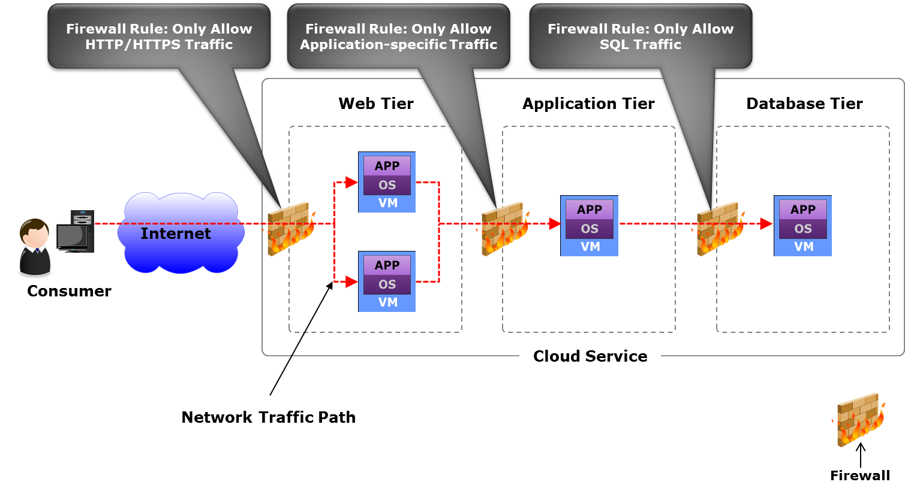
Example: Creating a Security Architecture
Notes:
This example illustrates a security architecture aligned with a provider’s approach towards information security management. It is created by the information security management team of provider’s organization to conform to security policy. It secures a cloud service by filtering incoming network traffic.
Given the context, a cloud service is divided into three tiers – web, application, and database. The web tier consists of two VMs (web servers) and all client traffic routed through Internet are load balanced (not shown in this architecture) across these VMs. The application tier comprises a single VM running application software; likewise, the database tier contains a single VM that provides database service. Communication between these tiers enables the cloud service to function.
The security architecture ensures that virtual firewalls are deployed when a service is provisioned. These firewalls examine network traffic traversing from/to VMs and only permit traffic that passes the firewall rules. In this example, network traffic from Internet to web tier is processed by a firewall, shown in the figure, that allows only HTTP or HTTPS traffic according to the firewall rule. The traffic from web tier to application tier is processed by another firewall that permits only deployed application-specific traffic. Similarly, the network traffic from application tier to database tier is filtered by another firewall that allows only Structured Query Language (SQL) traffic.

Slide 71
Lesson Summary
During this lesson the following topics were covered:
Incident management
Problem management
Availability management
Information security management
Notes:
This lesson covered incident management, problem management, availability management, and information security management.

Slide 72
Concepts in Practice
EMC Smarts
VMware vCenter Operations Management Suite
VMware IT Business Management Suite
Notes:
The Concepts in Practice section covers three products that facilitate cloud service management. These products are: EMC Smarts, VMware vCenter Operations Management Suite, and VMware IT Business Management Suite.
Note:
For the latest information on EMC products, visit www.emc.com.
For the latest information on VMware products, visit www.vmware.com.

Slide 73
EMC Smarts
Smarts
Enables discovery of infrastructure components Detects changes in component status Pinpoints impending service-affecting problems and identifies root cause
Notes:
EMC Smarts discovers infrastructure components and details information about each one, including configuration and inter-relationship among components. It monitors configuration, performance, and availability and provides reports on monitored components. Smarts detects changes in the status of the infrastructure components such as a failure or a performance degradation that may occur due to problems. It analyzes and correlates these status changes, pinpoints impending service-affecting problems, and identifies root causes of the problems. By proactively finding root causes, it helps administrators to quickly identify services that are at risk of an SLA breach, so they can take corrective actions before consumers know that there is a problem. Smarts also defines how IT problems affect services and consumers, which helps administrators to prioritize actions.

Slide 74
VMware vCenter Operations Management Suite and IT Business Management Suite
vCenter Operations Management Suite |  | IT Business Management Suite
Automates performance, capacity and configuration management Includes four components: vCenter Operations Manager vCenter Configuration Manager vCenter Hyperic vCenter Infrastructure Navigator |  | Automates financial management process Enables management of service levels and quality Enables management of vendors/suppliers
Notes:
The VMware vCenter Operations Management Suite includes a set of tools that automates performance, capacity, and configuration management, and provides an integrated approach to service management. It enables IT organizations to ensure service levels, optimum resource usage, and configuration compliance in virtualized and cloud environments. The vCenter Operations Management Suite includes four components. These components are described below:
vCenter Operations Manager provides operations dashboards to gain visibility into the cloud infrastructure. It identifies potential performance bottlenecks automatically and helps remediate them before consumers notice problems. Further, it enables optimizing usage of capacity and performs capacity trend analysis.
vCenter Configuration Manager automates configuration management tasks such as configuration data collection, configuration change execution, configuration reporting, change auditing, and compliance assessment. This automation enables organizations to maintain configuration compliance and to enforce IT policies, regulatory requirements, and security hardening guidelines.
vCenter Hyperic monitors hardware resources, operating systems, middleware, and applications. It provides immediate notification in the event of application performance degradation or unavailability. This enables administrators to ensure availability and reliability of business applications.
vCenter Infrastructure Navigator automatically discovers application services running on the VMs and maps their dependency on IT infrastructure components.
(Cont'd)

Slide 75
VMware vCenter Operations Management Suite and IT Business Management Suite
vCenter Operations Management Suite |  | IT Business Management Suite
Automates performance, capacity and configuration management Includes four components: vCenter Operations Manager vCenter Configuration Manager vCenter Hyperic vCenter Infrastructure Navigator |  | Automates financial management process Enables management of service levels and quality Enables management of vendors/suppliers
Notes:
The VMware IT Business Management Suite automates financial management process, giving fact-based views of service costs across physical, virtual, and cloud environments. It displays IT costing including TCO and unit costs along with their breakdowns and trends for all services. It also helps finance departments to rationalize budgets and track planned versus actual spending, and provides what-if scenarios such as how service costs would be affected if a vendor is replaced or an application retired. Further, the IT Business Management Suite can compare an organization’s cost structure against peer organizations. It can identify the areas where an organization is doing well and where the organization could improve to better align IT capabilities and costs with the organization’s goals.
The IT Business Management Suite also enables an organization to define, track, and manage service levels and quality metrics. Alerts are generated when an SLA or contract commitment is in danger of being missed.
Further, it creates workflows to track, and approve vendor agreements and commitments. It also tracks, validates, and manages vendor invoices against contract terms, spending, and service performance metrics.

Slide 76
Module Summary
Key points covered in this module:
Service catalog management, financial management, and supplier management
Monitoring, service asset and configuration management, change management, capacity management, and performance management
Incident management, problem management, availability management, and information security management
Notes:
This module covered the key service management processes – service catalog management, financial management, supplier management, monitoring, service asset and configuration management, change management, capacity management, performance management, incident management, problem management, availability management, and information security management.

